Slide 1

Leadership Collaborative
Communications Web Meeting
June 15, 2018

Slide 2
Agenda
Introductions
Core messaging
Our platform
Website refresh

Slide 3
Introductions

Slide 4
Attendees
Laura Yunger – Chicago Communications Co-Chair
Abby Bensimhon – DC Metro Membership Chair, President Elect
Jenn Baldwin – Global Design Firm
Mary Adams – Global Executive Director
Angie Ellis – Global Chapter Administrator
Shelley Lombardo – Maryland Immediate Past President
Dina Wasmer – Maryland Communications
Ashley Agnew – New England Marketing
Steve Economou – Philadelphia President & Program Committee Chair
Hector Frietze – San Antonio Treasurer, Chair- Sponsorship and Marketing

Slide 5
Core messaging

Slide 6
Update from our last meeting
Last time, I shared that there were many conversations about moving away from emphasis on exit planning
We held the annual meeting of XPX Presidents in April
After long conversations, we affirmed our niche and agreed to stick to the exit planning branding
BUT, we did agree to add a tagline to emphasize: “Growth, Transfer, Legacy.”
And we did agree that it would be good to do a website refresh

Slide 7
We affirmed our original vision
Our Vision
  Every business owner achieves a well-prepared and successful exit
Our Mission
  Make it easier for business owners to find and work with qualified professionals with deep exit planning expertise
  Support the growth of the emerging exit planning field
  Enable members to share their intellectual capital with other members
  Support the development of the tools, processes, and educational programs required for this emerging discipline
+ Principles (Values)….

Slide 8

Principles/Values
Adapted per discussion:
Work collaboratively
  Know where to find and how to work with other trusted advisors
Put the client first
  Avoid conflicts of interest, ensure confidentiality and be transparent
Think long-term
  Help clients understand and navigate the road to long term value
Consider the human angle
  Be aware of the complex relationship between the people and the business
Always be learning
  Advisors who are continuous learning help their clients keep up with rapid change

Slide 9

Member criteria
Expertise in one of our 12 professions
Works directly with owner and/or senior managers of lower middle market companies ($5 – 100 million in revenues)
Work is consistent with the XPX Principles

Slide 10
Our Platform

Slide 11
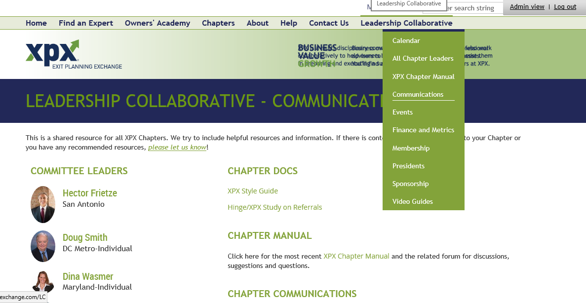

Slide 12
Our platform
Website – on Wild Apricot platform implemented 9/2015
  Chapter mini-sites
  Owners’ Academy posts and videos
  Monthly newsletter to 7,000 advisors
Meetings
  Email invitations
  At meetings: introductions, programming
LinkedIn Group
  757 members

Slide 13
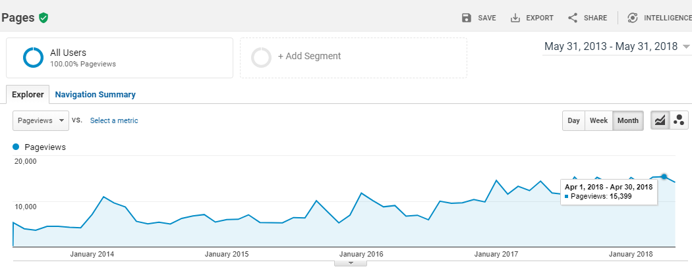

Slide 14
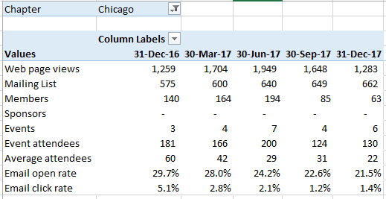
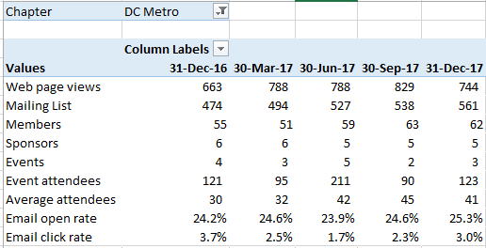
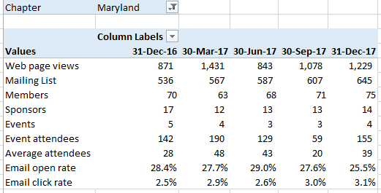

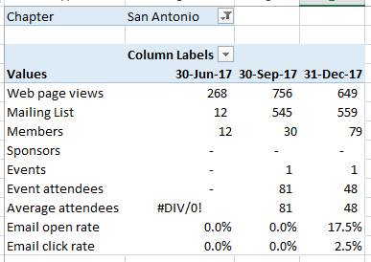


This is from the Metrics Pivot Table in the Leadership Collaborative Finance and Metrics page
Tri-State combined-Fairfield, Hartford, NY, NJ

Slide 15
Website Update

Slide 16
Strategic goals for the website
Serve needs of members
  Transactions, See and Be Seen, Resources
Help attract new members
  Learn about the organization, Understand the value
(Secondary: Help attract new Chapters)

Slide 17
Tactical steps
Underway:
Improving page SEO
Building product review section
Add advisor principles, member criteria to website
Next:
Add tagline to logo
Freshen look and content
Revisit benefits on Chapter home pages

Slide 18



Tagline
Add Growth, Transfer, Legacy or Growth, Exit, Legacy
(instead of Exit Planning Exchange)?

Slide 19
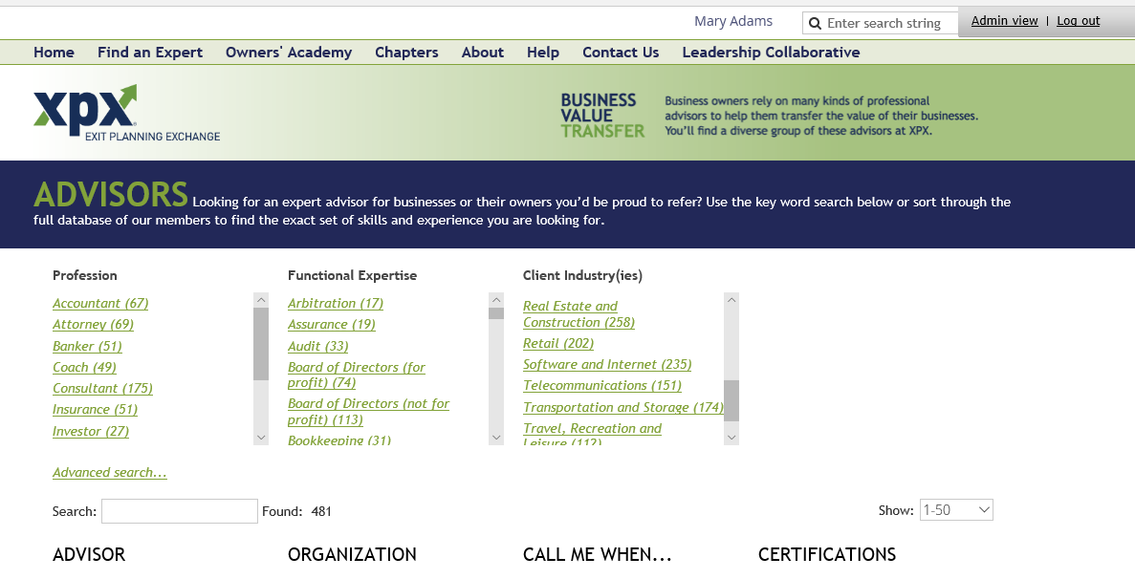

Slide 20
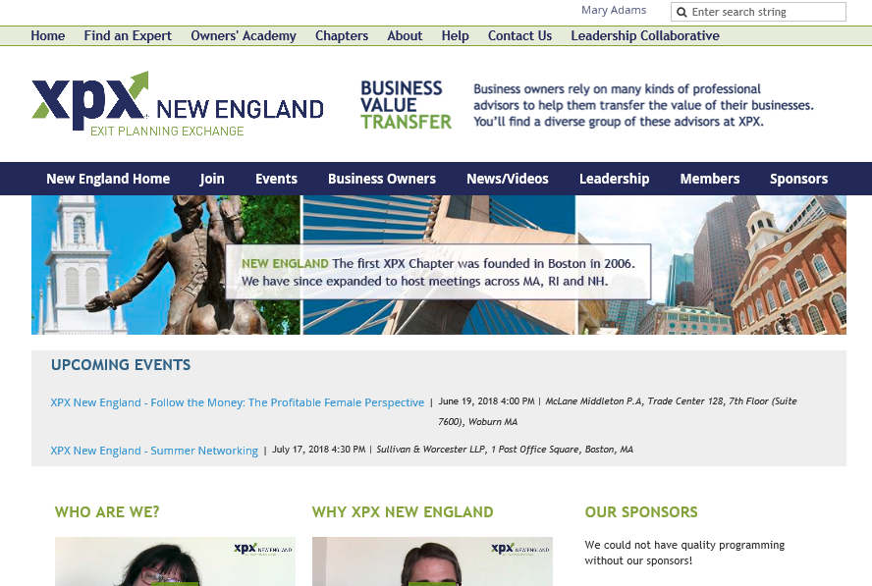

Slide 21
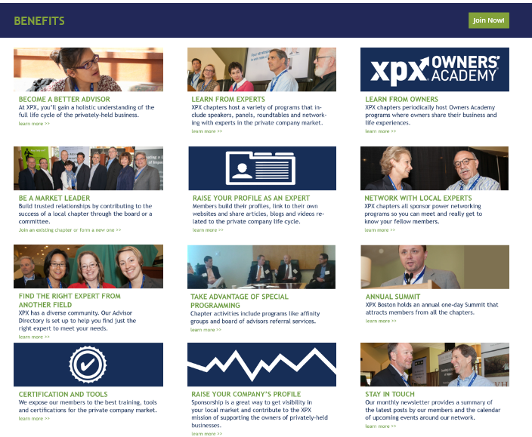

Slide 22
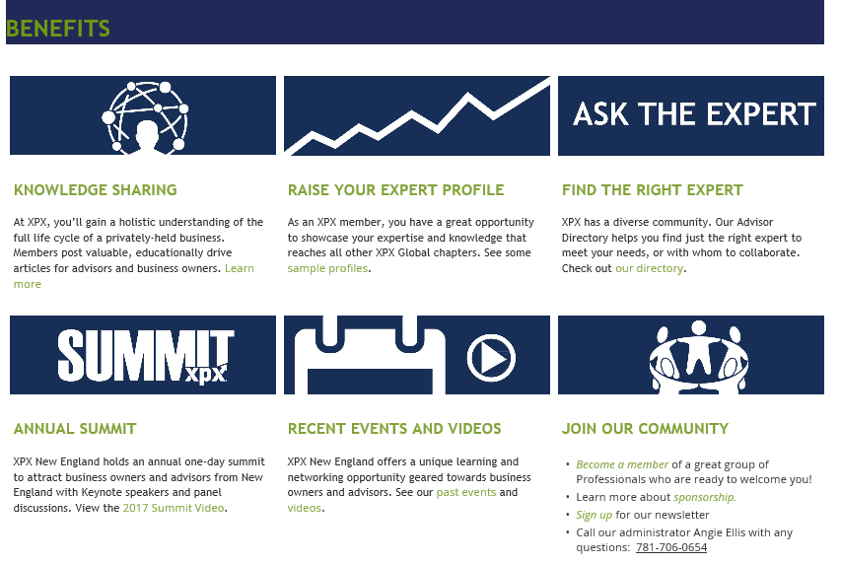

Slide 23
WHAT MAKES US SPECIAL? | HOW IS THIS DIFFERENT FROM OTHER ORGS?
Multiple people in room Expertise in transfer Don’t find this expertise in other org The members are the attraction Multiple peers, promotes humility Opportunities for multiple referrals in each category Broad range complementary skills Collaboration and connection Purpose driven, focused, practicing middle market Collaboration Attract relationship-driven advisors, long-term relationships and referrals Applications lead to higher quality, curated network, deeper knowledge of who you’re engaging with Tight mission, clarity of purpose enabling cross-referrals Learning: full cycle of business, lower-mid market Collaboration has to be real I’ve got the guy/gal to solve the problem | Case studies unique in professional Strategize how to help owners with the skills from other advisor, get new perspectives into groups of advisor Leading to new business Library of resources, content, cases Quality versus quantity, only bring those who can add to the discussions Interactive programming AM&AA and EPI are selling and are very focused BNI, networking: not focused, no learning ACG, TMA, …. All transaction oriented. We’re about the success of the company—longer term view To clients: did you know that I am part of a valuable network. How to make it easy for members to share this idea.

Slide 24
Benefits revisited
FEATURES | BENEFITS
Focus (only advisors to lower mid mkt private owners) | Leverage your time for maximum benefit
Purpose/Principles | Improve lives of owners, employees, local economies
Learning | Become a better advisor
Relationships | Meet the best advisors
Visibility | Become known for your expertise
Collaboration | Improve overall outcomes for your clients
…Others?
Show, not tell
Learning, Community/Networking, Visibility, (elsewhere) Principles
Link to events, member directory, owners academy, Click reference

Slide 25
LinkedIn
Company page – Global shares content from monthly webinars, re-post member posts from OA – ask members to follow?
Group – Global to try to start conversations, solicit stories using principles
Leaders – Welcome to post XPX positions in Experience
Members – Encourage sharing local events and content from profile
➔ Adding #exitplanning where possible

Slide 26
Next Steps
Global to circulate:
Mockup of new logo
Mockup of visual tweaks
Draft of benefits
What else do you need and/or want to see?
Ashley – good resources, a little busy, two nav bars, return to XPX home, more white space
Abby – first time guest free (Angie tracks manually)

