Slide 1

Leadership Collaborative
Communications Web Meeting
November 9, 2018

Slide 2
Agenda
Introductions
Messaging
Media
Discussion

Slide 3
Messaging

Slide 4
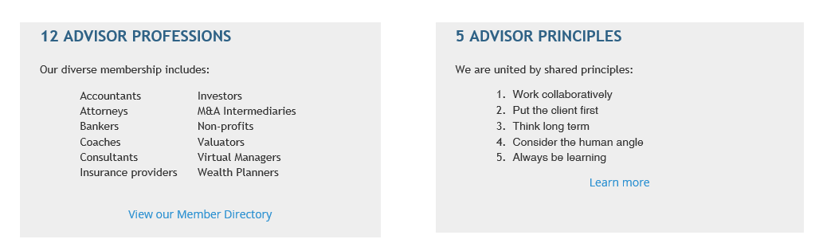
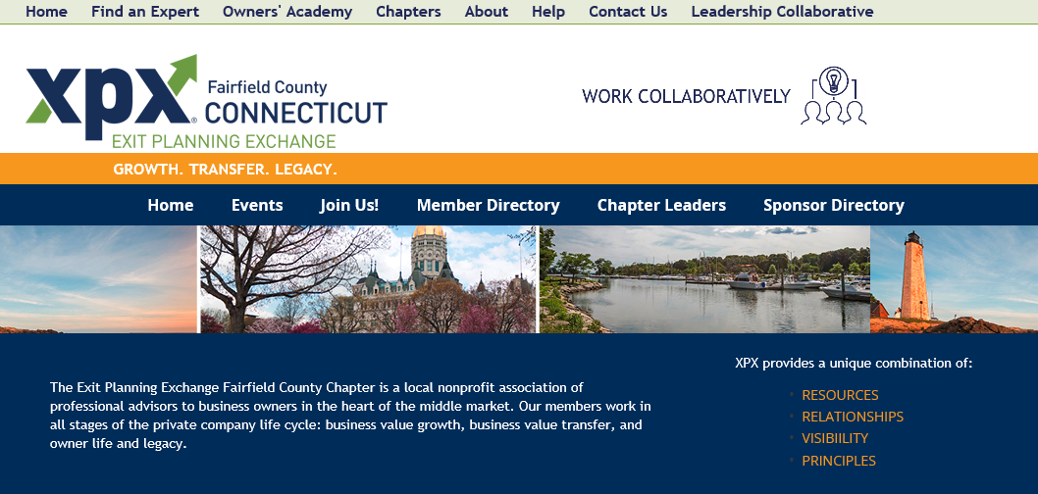
Value proposition
We all share the same target clients

Slide 5
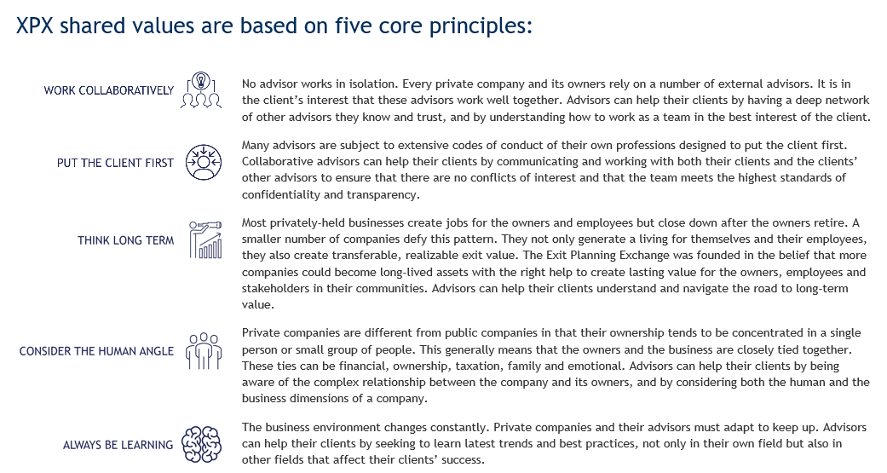
Advisor Principles
https://exitplanningexchange.com/advisor-principles

Slide 6
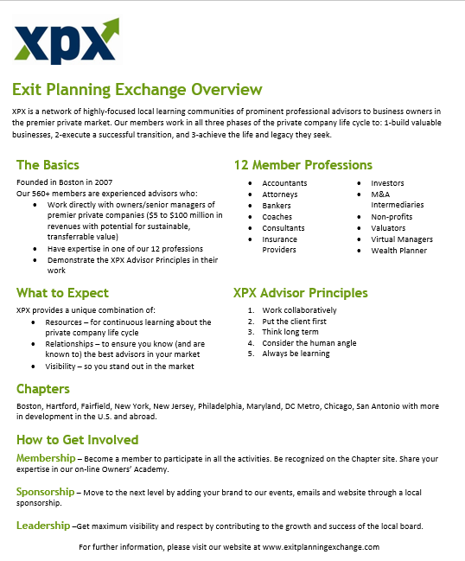
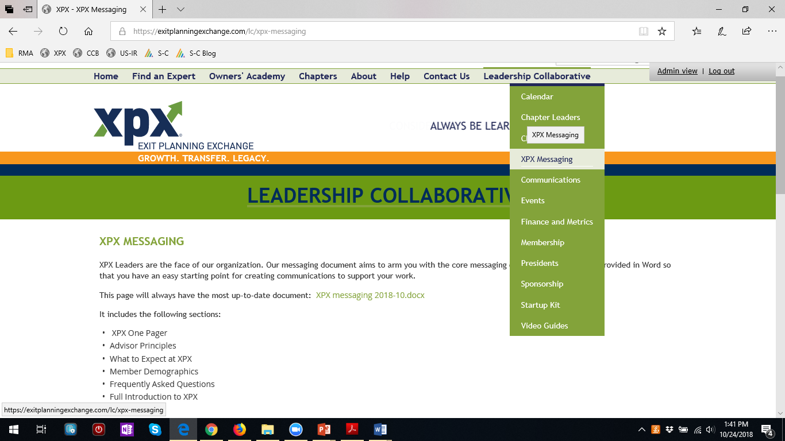
Messaging document
https://exitplanningexchange.com/lc/xpx-messaging

Slide 7
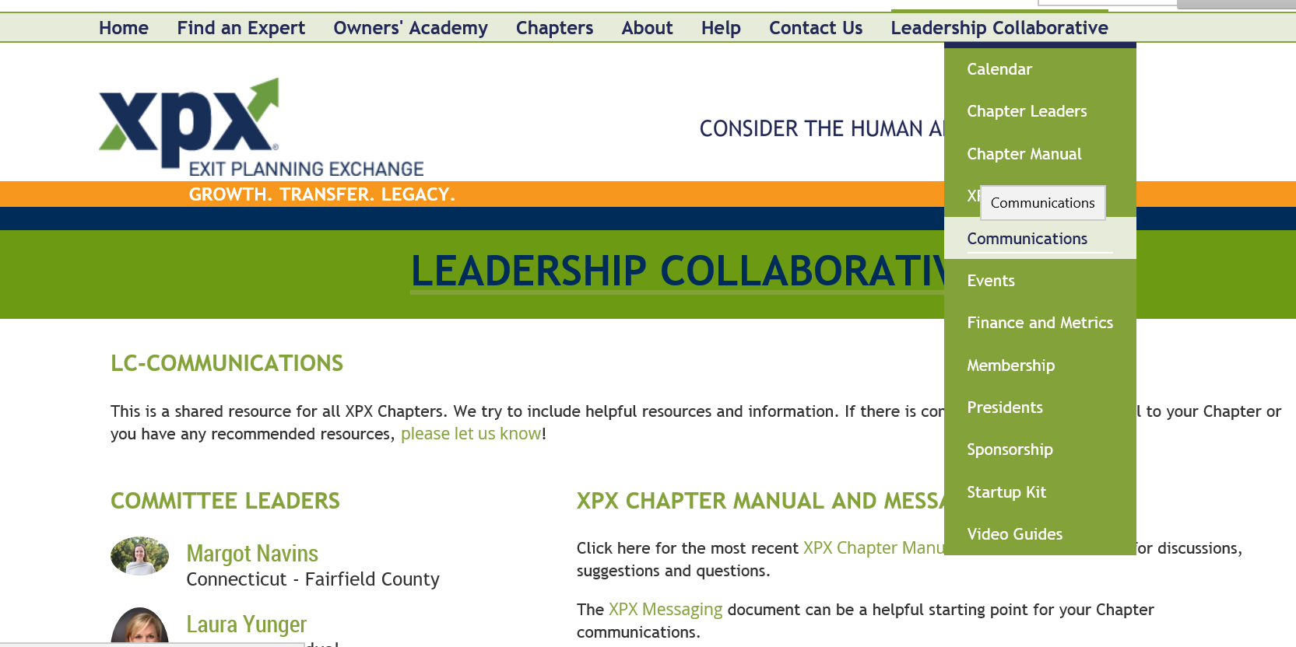
Leadership Collaborative
https://exitplanningexchange.com/lc/communications

Slide 8
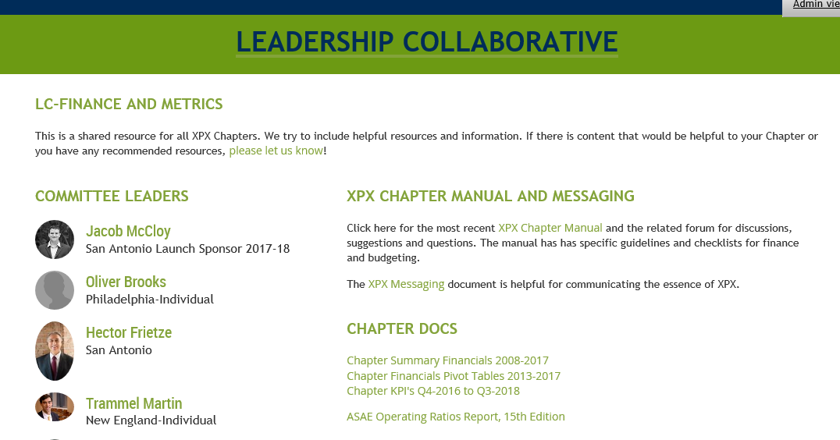
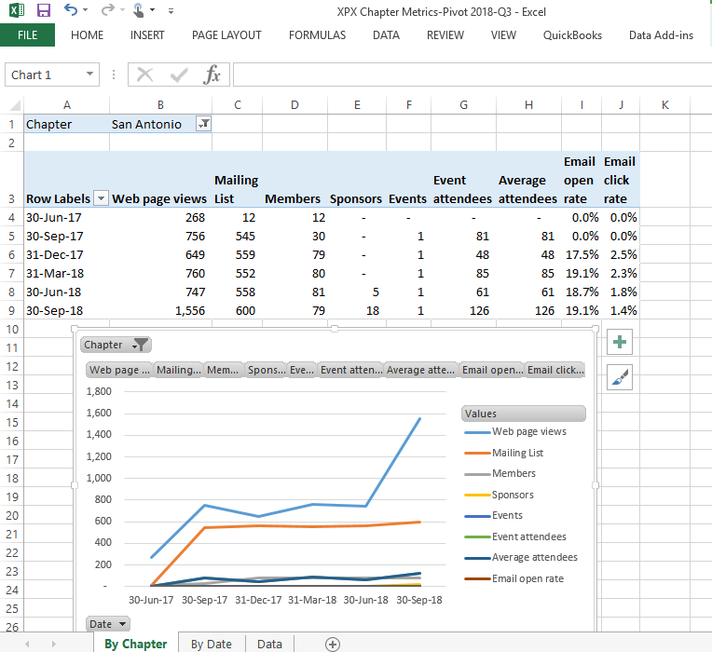
Metrics
https://exitplanningexchange.com/lc/finance

Slide 9
Media

Slide 10
Our platform
Website – on Wild Apricot platform implemented 9/2015
  Chapter mini-sites
  Owners’ Academy posts and videos
  Monthly newsletter to 7,000 advisors
Meetings
  Email invitations
  At meetings: introductions, programming
LinkedIn Group
  Group 757 members
  Company page 131 followers (new emphasis)
  Showcases

Slide 11
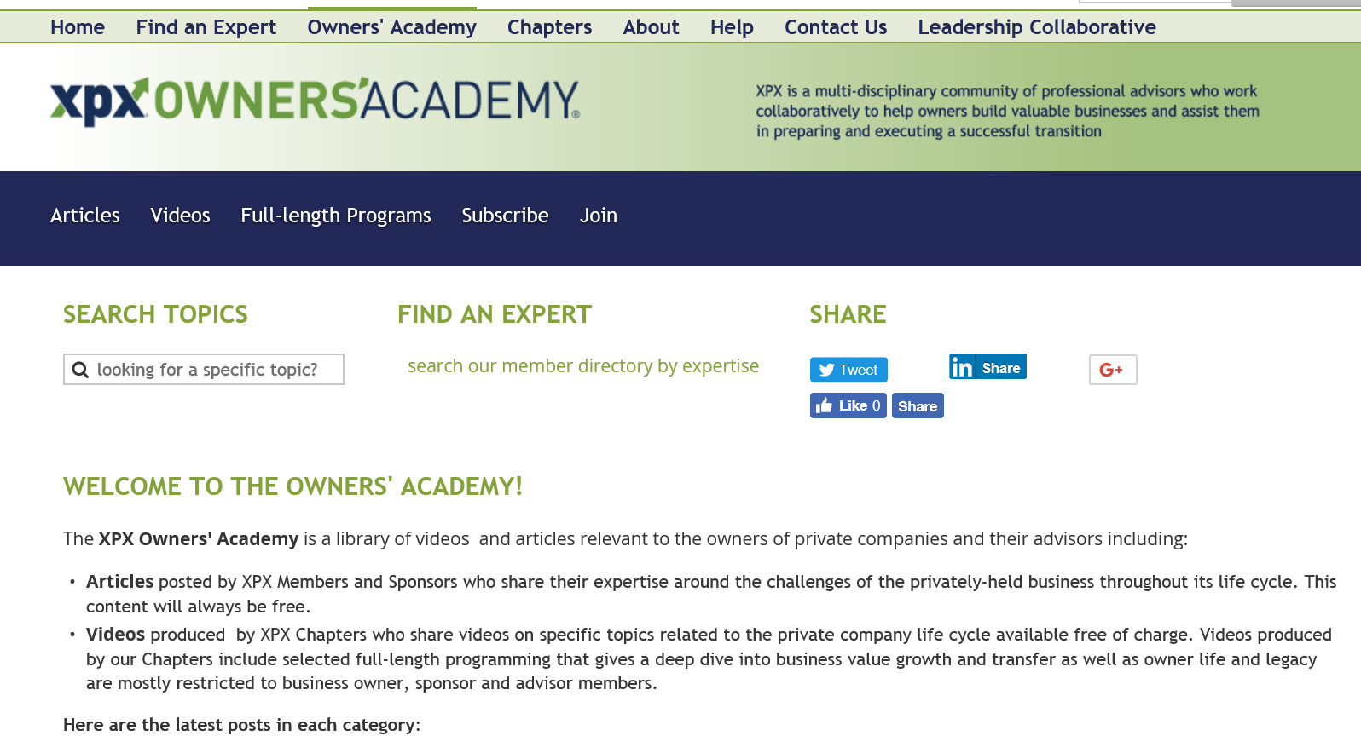

Slide 12
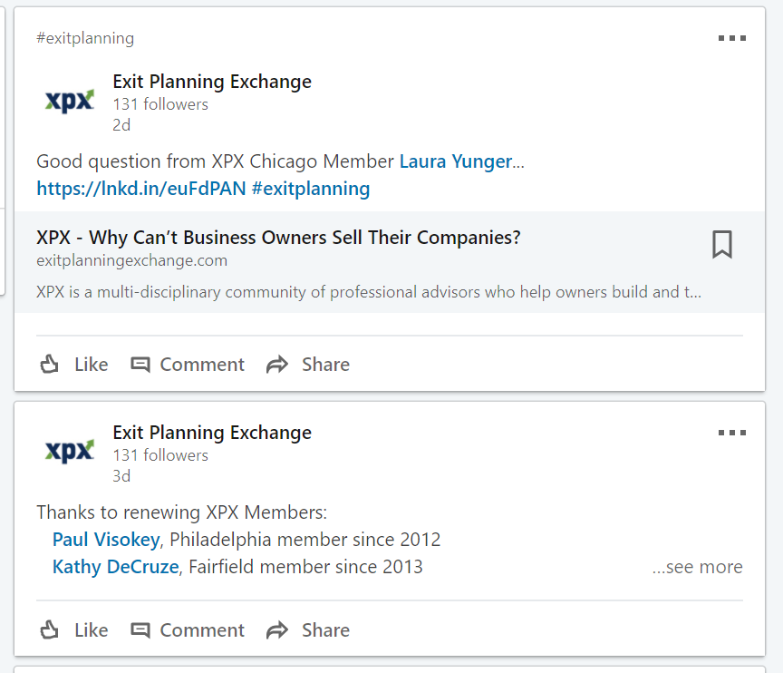
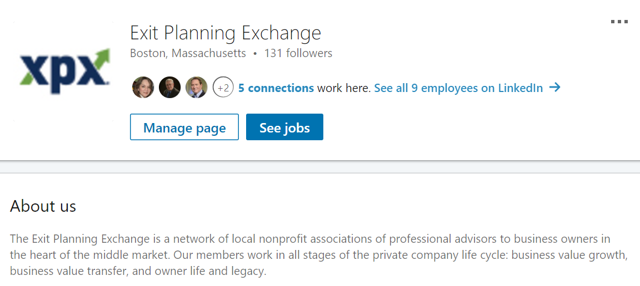
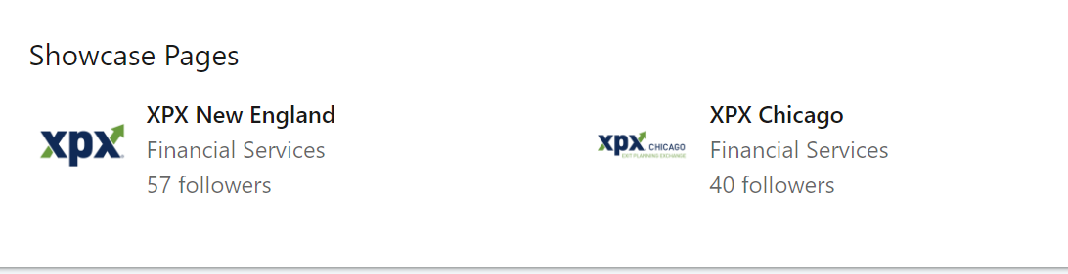
LinkedIn

Slide 13
Follow ups by Global
Add list of hashtags in Leadership Collaborative
Run trial of Chicago Showcase page
Fix sharing buttons on all templates
  Share on LinkedIn
  Follow up on LinkedIn
Help videos
  Add to calendar
  How to share:
    Like
    Share to feed
  Send message

